Slide 1
SIT113 Cloud Computing and Virtualisation
Week 7, Class 1
Cloud Technologies and Mechanisms

Slide 2
Outline
Data Centre Technology (Chapter 5)
Modern Data Centres
Technologies and Components

Slide 3
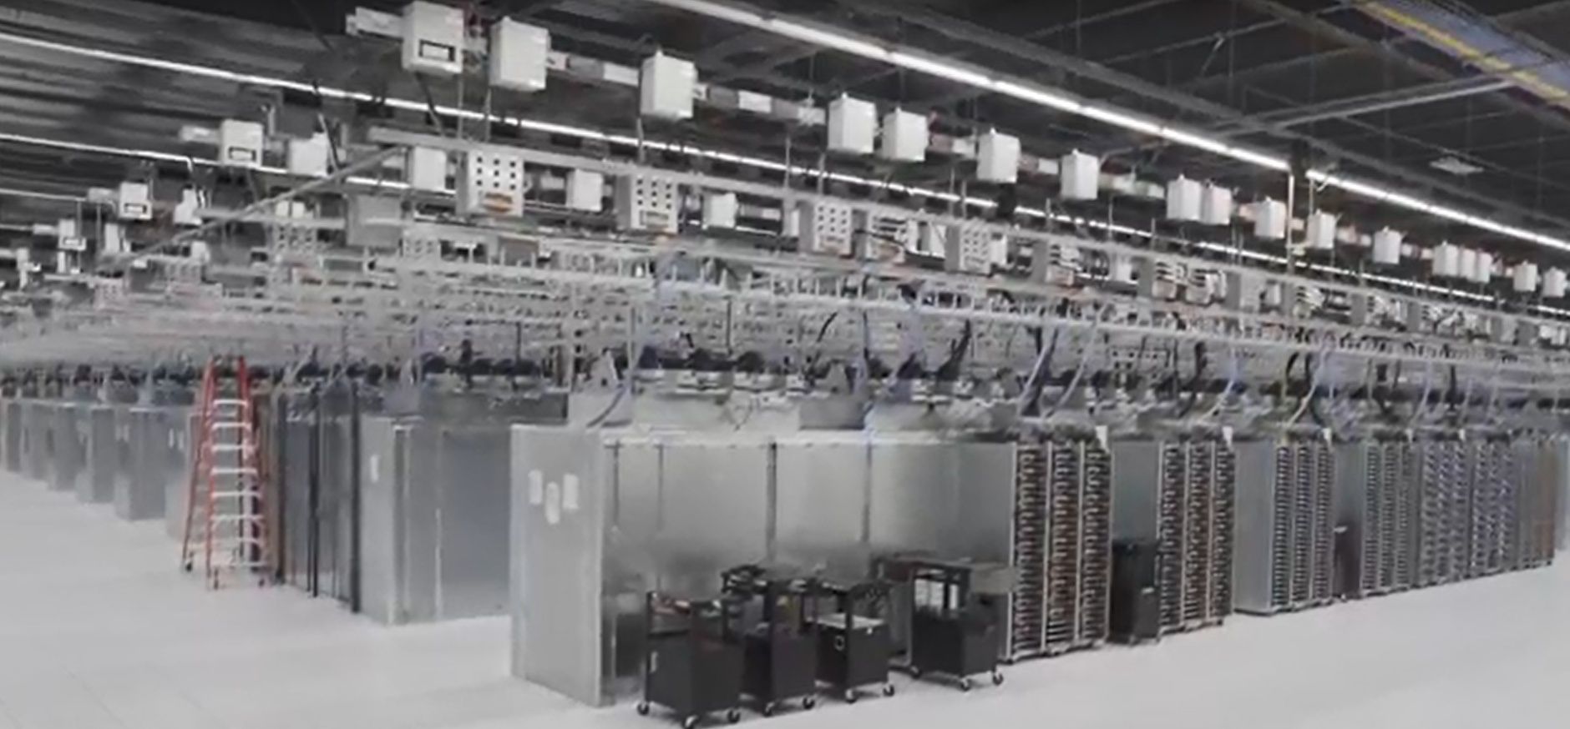
Modern Data Centres
https://www.youtube.com/watch?v=avP5d16wEp0

Slide 4
Modern Data Centres

Slide 5
Modern Data Centres
specialised IT infrastructure housing servers, databases, networking, telecommunication devices, and software systems
Grouping of IT resources enables:
power sharing
higher efficiency in shared IT resource usage
improved accessibility for IT personnel

Slide 6
Technologies and Components
Virtualization
Standardisation and Modularity
Automation
Remote Operation and Management
High Availability
Security-Aware Design, Operation, and Management
Facilities
Computing Hardware
Storage Hardware
Network Hardware

Slide 7
Technologies and Components
Virtualization: rather than direct usage of physical IT resources, virtualization platforms present an abstraction of physical resources that are easier to:
allocate
operate
release
monitor
control

Slide 8
Technologies and Components
Standardisation and Modularity: commodity hardware and modular architectures used as building blocks supports:
scalability
growth
speedy hardware replacements

Slide 9
Technologies and Components
Automation: without supervision, specialised platforms automate tasks including:
provisioning
configuration
patching
monitoring

Slide 10
Technologies and Components
Remote Operation and Management: most tasks can be completed through network-based:
remote consoles
management systems
For example, Vmware vSphere Web Client

Slide 11
Technologies and Components
High Availability: increased redundancy used to sustain availability
For example,
redundant UPS
cabling
environmental control (air conditioning, fire control, etc.)
communication links
clustered hardware for load balancing

Slide 12
Technologies and Components
Security-Aware Design, Operation, and Management: physical and logical access control and data recovery strategies

Slide 13
Technologies and Components
Facilities: custom-designed facilities outfitted with specialised computing, storage, and network equipment, including several functional areas, power supplies, cabling, environmental control stations, etc.

Slide 14
Technologies and Components
Computing Hardware: standardised commodity servers with substantial computing power and storage capacity
Rackmount form factor supporting standardised racks with interconnects for power, network, and internal cooling
Support for different hardware processing architecture, e.g., x86-32, x86-64, RISC

Slide 15
Technologies and Components
Power-efficient multi-core CPU architectures
Redundant and hot-swappable components, e.g., hard disks, power supplies, network interfaces, storage cards
Blade server architectures for improved interconnection and reduced physical space/power requirements

Slide 16
Technologies and Components
Storage Hardware: specialised storage systems to maintain enormous amounts of digital information
Hard Disk Arrays: divide and replicate data among multiple physical drives, increasing performance and redundancy (RAID)
I/O Caching: disk array controllers enhance disk access times and performance by data caching

Slide 17
Technologies and Components
Hot-Swappable Hard Disks: can removed/replace disks in arrays without requiring powering down
Storage Virtualization: using virtualized hard disks and storage sharing
Fast Data Replication Mechanisms: snapshotting and volume cloning

Slide 18
Technologies and Components
Storage Area Networks (SANs): physical data storage media connected through a dedicated network providing block-level data storage
Network-Attached Storage (NASs): containing and managing hard drive arrays and a network providing file-centric data storage

Slide 19
Technologies and Components
Network Hardware: extensive networks to provide multiple levels of connectivity
Carrier and External Networks Interconnection: connectivity between external WAN and data centre’s LAN, firewalls, VPNs, etc.
Web-Tier Load Balancing and Acceleration: pre-processors, encryption/decryption appliances, Layer 7/content-aware routing

Slide 20
Technologies and Components
LAN Fabric: high performance and redundant connectivity for all data centre IT resources (usually 10Gbps+)
SAN Fabric: used in SANs, usually Fibre Channel (FC), Fibre Channel over Ethernet (FCoE), or InfiniBand
NAS Gateways: attachment points for NAS devices and facilitates data transmission between SAN and NAS devices

Slide 21
Summary
Data Centre Technology (Chapter 5)
Modern Data Centres
Technologies and Components

